Slide 1
Low temperature Dissipation Phenomena in Micro and Nanomechanical systems.
Ananth Venkatesan
IISER Mohali

Slide 2
Overview of talk
Over view of NEMS/MEMS as a Physical System
Overview of Quantum Friction/TLS
TLS in NEMS
Non-linear Damping
Other Phenomena in dissipation

Slide 3
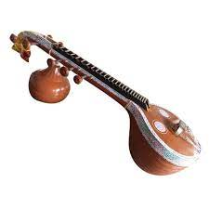
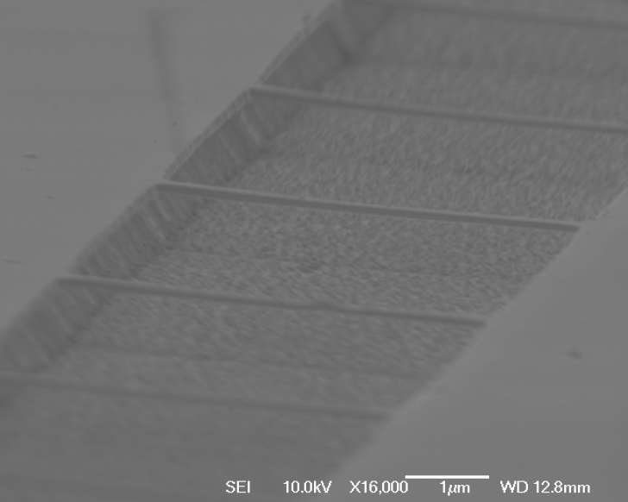
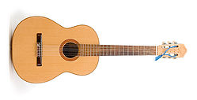
Analogs
Typically resonates in
RF frequency
Of few MHz
Typically resonates in
Audio frequency Hz to few Kilo-Hz
An array of doubly clamped
Gold beams about 200nm wide
And 80 nm thick and few microns
Long.
A nano-scale analogue of a stringed Instruments

Slide 4
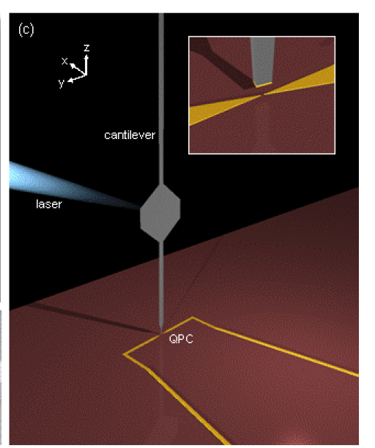
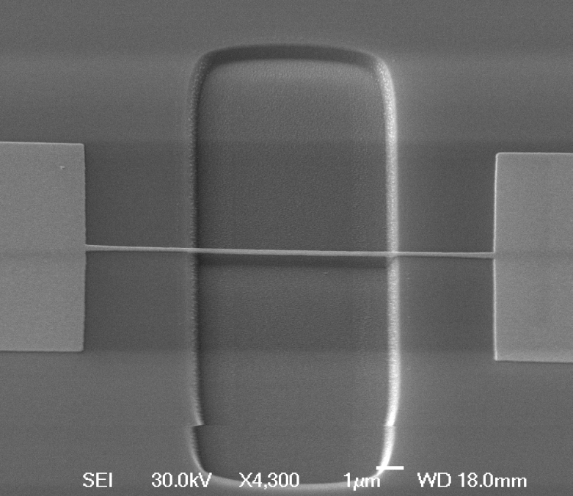
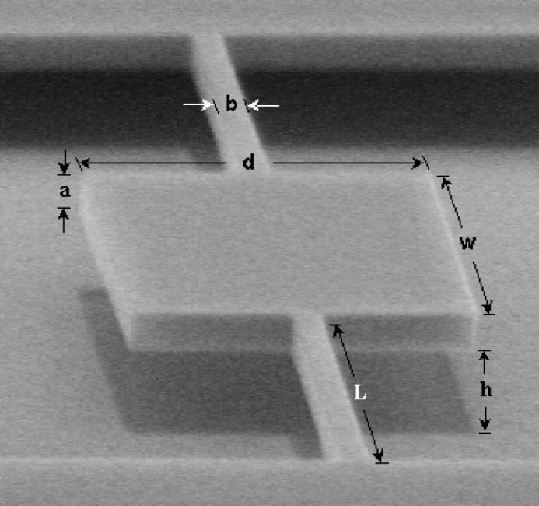
Typical geometries of Nano-mechanical resonators.
Doubly clamped beams
Of Gold
Venkatesan et.al
Phys Rev B
Tosrional resonators
Parpia’s Group
Cantilvers
M.Poggio et.al
Notes:
4

Slide 5
Differences between NEMS/MEMS and large scale resonatorS
Extremely small
Typically resonates in radio-frequencies
Extremely high-Q expected ???
(due to poor coupling to environment)
Macroscopic
Typically resonates in acoustic frequencies
Typically low Q-factors
Notes:
5

Slide 6
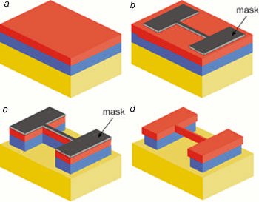
Typical NEMS Fabrication processes.
Device layer
Pattern mask
Using techniques
Like e-beam
Lithography and
Thin film coating .
Cf: Ekinci and Roukes
Rev Sci Inst
Sacrificial
Layer
Handle wafer
Selectively etch
Sacrificial layer with undercut in
Narrow regions of device to
Suspend the sample.
Metallic NEMS are simpler
A separate sacrificial layer is
Not needed.
Etch through device and sacrificial layer using low
Pressure Plasma

Slide 7
Bigger doesn’t mean easier always!
An array of Sub-micron Gold beams that are suspended\
Easily by etching without sticktion
International Journal of Quality Statistics and Reliability 2011(1687-7144)
Some tricks use methanol to dry or freeze dry ethanol
If critical point dryer is not availble

Slide 8
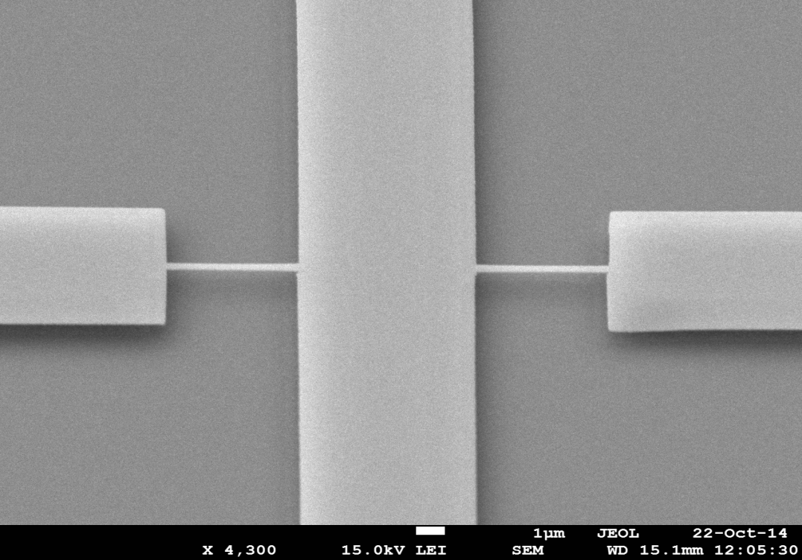


Some fabricate devices
(a)
(b)
Suspended Pd
beams.
Floating markers showing
Device is ready

Slide 9
Applications of NEMS
Desirable properties of NEMS
Typical applications
High Q-Factors .
Small size and low power consumption down to atto-watts
Extremely sensitive force transducers
Easy tunability of linear and non-linear behaviour.
Works as excellent filters
Can be scaled to fit in existing IC technologies.
Excellent Force /Mass sensors
applications like local MRI, detector for traces of gases etc
Finds applications in devices like paramateric amplifier.
Chaos based computing .
(Prof S. Sinha @ IISER Mohali)
Notes:
9

Slide 10
Applications of NEMS
A NEMS based mass sensor capable of sensing attograms
(10 ⁻¹⁸ gm) of change by measuring frequency shift of the
cantilever. B. Ilic et.al. Appl. Phys. 95, 3694 (2004)
Notes:
10

Slide 11
Why Physicists are interested in NEMS?
1) Sensitive transducers always mean better physical measurements. Examples of applications in physical measurements include magneto-meters, charge sensors
2) NEMS by themselves are extremely interesting systems especially at ultra low temperatures.
Notes:
11

Slide 12
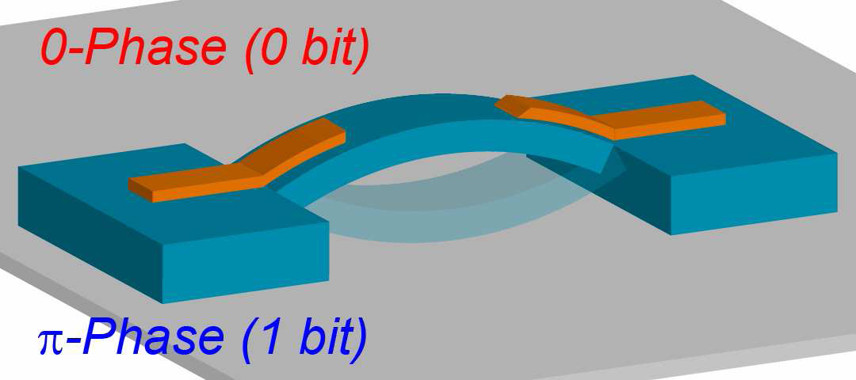
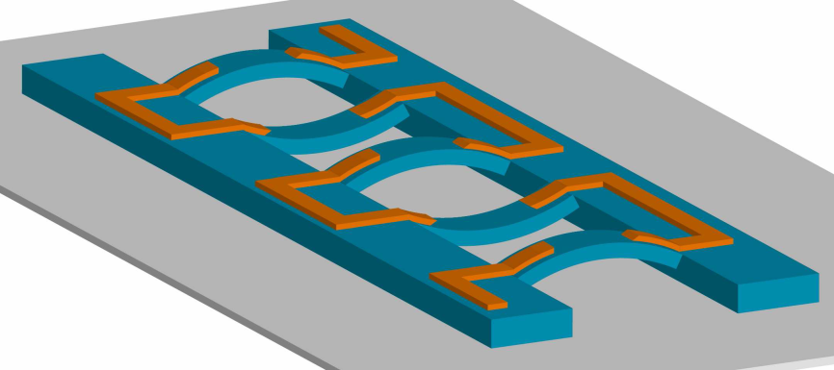
NEMS based computing
Bit Operations can be synchronized by paramtric resonance
Or stochastic resonance schemes
A whole array can
Be read to process
Digitzed information.
I.Mehboob & H.Yamagichi Nature nano-tech. 3, 275279 (2008)
Notes:
12

Slide 13
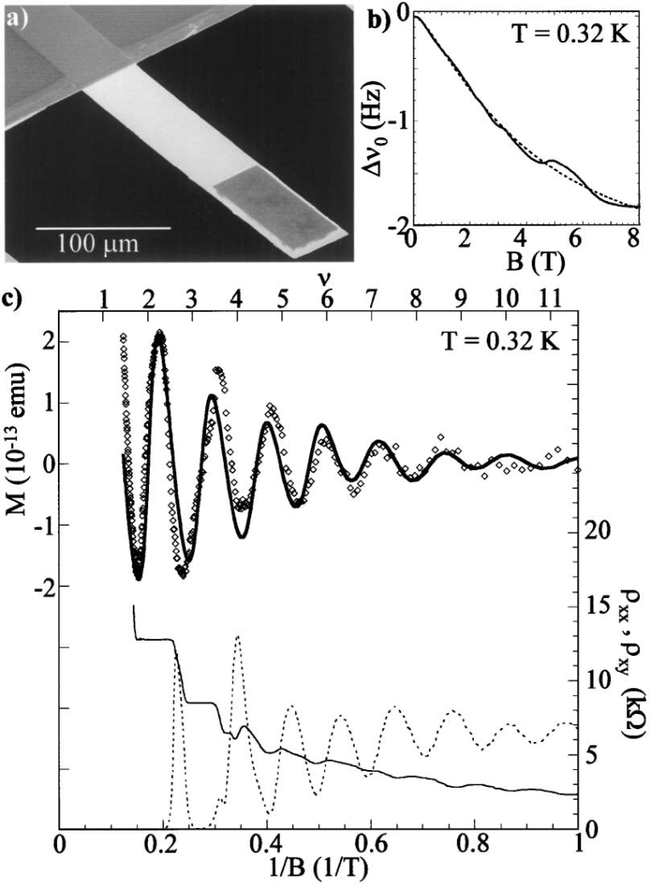
Magnetization of 2-D elecron systems
gate
oxide
++++
+++
S
-------------
D
Inversion layer forming
2-DEG
P-type substrate
2-DEG on a cantilever
DHVA effect seen
clearly
Phys Rev Lett 86 4644(2001)
Notes:
13

Slide 14
A Nano-mechanical Electrometer
Gate where a small voltage
Is applied
Torsional Resonator detected by
A magnetomotive scheme.
A charge on the gate alters the f
Frequencies.
Notes:
14

Slide 15
NEMS as a platform for various physical phenomena
Non-linear Phenomena and Chaos (possible to easily map states of a fast system than a low frequency system)
Macroscopic Quantum Phenomena (MQP) In principle a device with frequency satisfying
hω>>KT is possible to make.
Devices with GHz frequencies can achieve the condition at T~10mK .
Such temperatures are routinely achievable in a dilution fridge
Low frequency devices can cool via Microwaves
Notes:
15

Slide 16
Nonlinearity and Chaos examples
Kozhinsky et.al PRL 99, 207201 (2007)

Slide 17
Microwave transduction Schemes
Measuring nanomechanical motion with a microwave cavity interferometer
C. A. Regal, Teufel, J. D., and Lehnert, K. W., Nature Physics 4, 555-560 (2008).

Slide 18







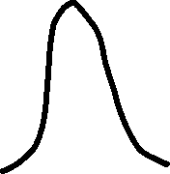




































Cavity + Beam
Aalto off the shelf
microwave
Resonator
Accessing nanomechanical
resonators via a
fast microwave circuit APL and
Nanoletters
Transmission Line resonator

Slide 19
Side bands etc
C. A. Regal, Teufel, J. D., and Lehnert, K. W., Nature Physics 4, 555-560 (2008).
Phase slips
Mechanical
Motion
?????

Slide 20
Back action etc
Naik A, Buu O, LaHaye MD, Armour AD, Clerk AA, Blencowe MP, Schwab KC. Cooling a nanomechanical resonator with quantum back-action. Nature. 2006 Sep 14;443(7108):193-6. doi: 10.1038/nature05027. PMID: 16971944.
Massel, F., Heikkilä, T., Pirkkalainen, JM. et al. Microwave amplification with nanomechanical resonators. Nature 480, 351–354 (2011). https://doi.org/10.1038/nature10628

Slide 21
Resonant response of mechanical structures
References:
Tero T. Heikkilä Physics of Nanoelectronics ( clear overview )
Cleland Foundations of Nanomechanics ( very detailed text)
Resonant Structures
Von-Karman & Biot Mathematical Methods in Engineering and Physics
Landau Lifshitz Theory of Elasticity

Slide 22
Doubly clamped NANO beams
E is Young’s modulus of gold , ρ density, A cross sectional area of beam.
I = t³w/12 moment of inertia of beam, l length of the beam.
is the additional tension due
To differential thermal
contraction between the beam
And substrate on cooling.

Slide 23
Quartz Crystals and other large oscillators
A Gold and Tantalum Coated Quartz crystal Micro-Balance/resonator Representation of Shear Modes
Created by AC voltages in Quartz

Slide 24
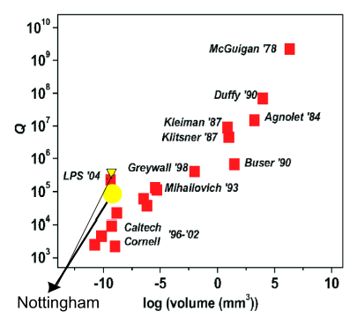
Dissipation Scaling with size
Q as a function of Size/ frequency
Figure adpated from K. Ekinci & M.Roukes
Rev Sci Inst. 76:061101, (2005).

Slide 25
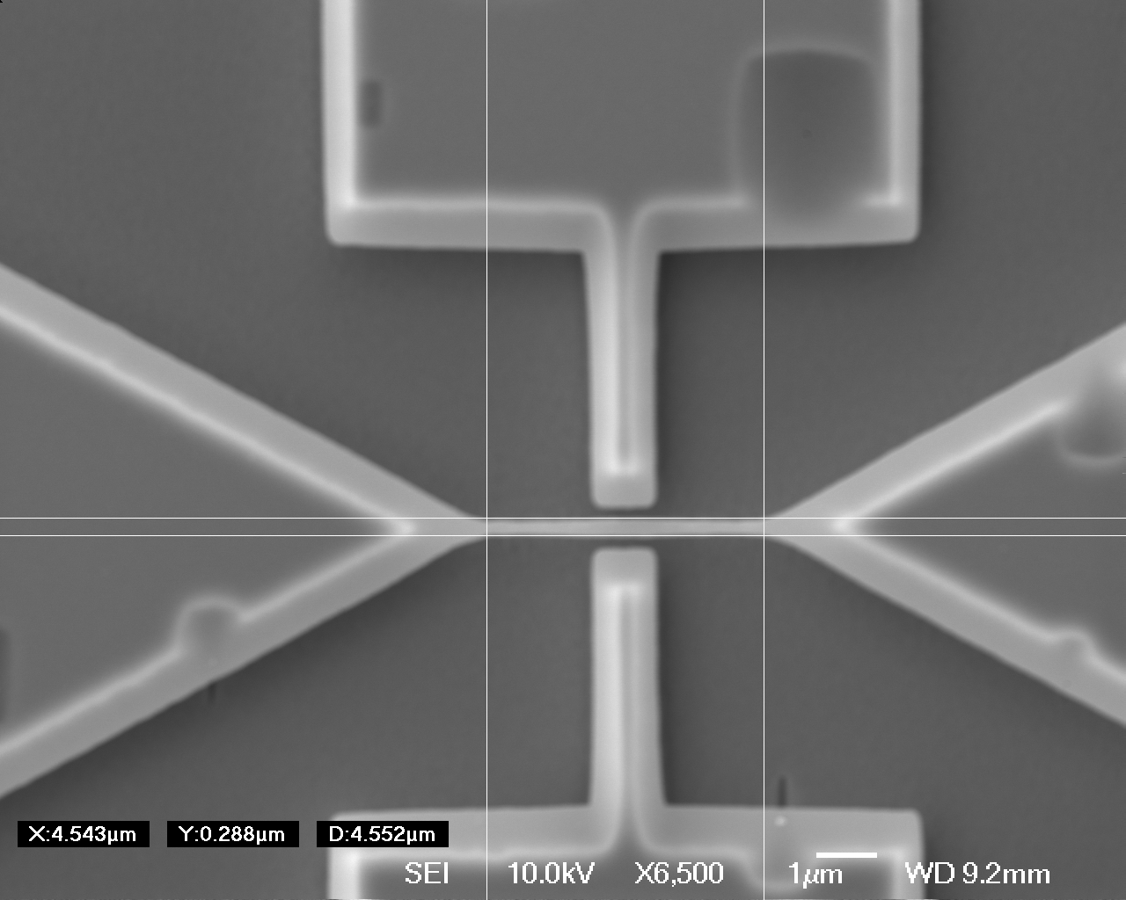
Typical Loss mechanism in NEMS
External transducers
or circuits connected to
the device. E.g
SETs from A. Naik et.al
Nature are examples of
External transducers
Or simply B fields.
Non-equilibrium
Thermal phonons
Clamping losses at
Boundaries of
resonator (very important
In small resonators)
Surface defects

Slide 26
Schematic of magneto-motive technique:
A gold Nanomechanical resonator
V
I(ω)
Lorentz Force
F = ILB
B field
Parallel to
beam
Semiconductor
Substrate
Beal length ~5 microns.
Width ~250-300nm >> thickness ~ 80nm

Slide 27
Dissipation due to measurement schemes

Slide 28
Role of external circuits :
R
C
If V_{in} is the input voltage
And V₀ is the measured
Output in an amplifier
(V₀/V_{in} ) = Z₀/(Z_{s}+Z₀+Z_{LCR})
At resonance Z_{LCR} has a
Peak with the impedance
being real.
But the measured response is
Smaller by a ratio proportional
to input and output
impedances .
V_{in}
Z_{s}
Z_{o}
L
V₀
NEMS resonator can be modeled as
a parallel LCR resonator with external load.
Ref : Cleland & Roukes Sens & Actuators 72 , 256 (1999)

Slide 29
Extraction of intrinsic Q :
T~600mK
→B=3T
Where R_{m} = (ζl²B²Q_{o}) /(mω_{ο}²)
Hence Q_{L} expected to have a
Quadratic dependence on B.
The expected slope is around
2.44x10⁻⁶/T².
T~ 10mK
Slope corresponds
to external
impedances and
Constants in R_{m}
Intercept yields Q_{o}
. Q_{o}~70000 at T=10 mK
Q₀~29000 at T =600mK

Slide 30
What happens below 4.2 K
All Solids typically freeze below 4.2 K
Thermal conductivity drops as phonon DOS is reduced
Most expansions/contractions are negligible
Yet most Solid state mechanical systems show temperature dependence of frequency and dissipation down to few mK
WHY?
Only Helium forms a superfluid
Typically Quantum fluctuations persists among defect states

Slide 31
Defects in Crystals
Lets see: Diamonds are crystals and, as we are told, they are forever (a lie) and ……….. but if you buy one, it is mostly the defects in this carbon crystal that determine how much money you spent for a given size.
If you do not buy diamonds on a regular base, you are still exposed to defects in crystals in many ways. However, you may not be aware of this fact. So let's look at examples.
You can see an interesting online resource on defects by Prof H. Föll Univ of Kiel
https://www.tf.uni-kiel.de/matwis/amat/def_en/index.html

Slide 32





















Tunnelling two Level Systems (TLS) Phenomenology
Magnetic ions
Dopants
Defects
LOGIC everything is close to ground
State so excitation to next level is sufficient
To explain dissipation
Grain Boundaries

Slide 33
Dissipation due to defects in solids at low temperatures.
At low temperatures defects in solids can be represented as a
Tunneling phenomena in a
2 level system . Typically the lowest levels are occupied .
states coupling by strain fields
drives two level
Systems to excited
few excitations
Relax back to ground
State
Time

Slide 34
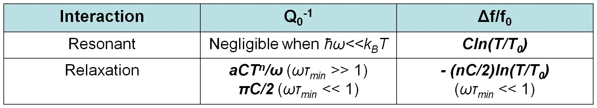








TLS models for bulk amorphous solids
χ = χ’ + i χ”
T<T*
T>T*
n =1 for electrons
n =3 for bulk phonons
n =1 for quasi 1-D phonons

Slide 35
Q⁻¹ = πC/2
Log (Q⁻¹)
Dissipation
T ^{n}
n = 3 (PHONONS)
n = 1 (ELECTRONS)
T*
Log T
Two-level systems (TLS) with broad distribution of energies and relaxation times → Dissipation due to resonant and relaxation absorption by TLS
Assuming TLS at the surface → Q₀ ⁻¹ ~ T^{1/2}
(C Seoanez et.al Phys Rev B 77 125107 (2008))
(Fefferman et al., PRL 100,195501(2008))

Slide 36
References for TLS Phenomena
P. Esquinazi Editor Tunneling Systems in Amorphous and Crystalline Solids 1998 Springer (collection of data and theory in several systems)
M. Imboden and P. Mohanty Physics Reports Volume 534, Issue 3, 20 January 2014, Pages 89-146 (Detailed review of TLS in NEMS)
C.H. Enss & R. Hunkilnger “Low Temperature Physics” Springer 2005
V. Braginsky et.al Systems with Small Dissipation Univ of Chicago press

Slide 37
Tuning Two-level systems or ensemble of environmental qubits
* Strain fields are Pseudo Magnetic
fields that act on Pseudo Two level
Spins of environmental qubits.
Phonon and other quasiparticles may
Interact with TLS.
Enhancing internal strain tunes
TLS Phonon couplinb
S. Rebari et.al Tunable low-temperature dissipation scenarios in palladium nanomechanical resonators Phys Rev B

Slide 38
Frequency shifts from High to low temperatures in Gold beam

Slide 39
Dissipation data in gold.
5 micron long f~7.9 MHz
7.5 micron long f~3.9 MHz
T^{1/2}
POWER
law
Below T*
Logarithmic
Relative
Frequency shifts below
T*.

Slide 40
Dissipation without H2

Slide 41
Dissipation with h2
TLS Phonon co-operative Dicke mechanism
Ahn & Mohanty Phys Rev Lett

Slide 42
.Do electrons play a role In TLS
Lulla, K., Defoort, M., Blanc, C., Bourgeois, O., and
Collin, E. (2013). Evidence for the role of normal-state electrons in nanoelectromechanical damping mechanisms at very low temperatures.
Physical review letters, 110(17):177206
Key result Response is highly non-linear when beam is superconducting

Slide 43
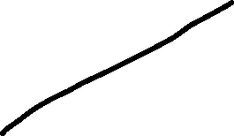
Dissipation in Nb_3Ge beams
Frequency too low in few 100 KHz regime

Slide 44
Vortices in High Tc drums
Superconducting vortex-charge measurement using cavity electromechanics
Authors
Sudhir Kumar Sahu, Supriya Mandal, Sanat Ghosh, Mandar M Deshmukh, Vibhor Singh

Slide 45
Overview of Non-linearity in NEMS

Slide 46






Duffing systems
Harmonic
Oscillator terms
Cubic term responsible for
Non-linearities starting with
Frequency shifts to
Bifurcations at extremely large drive
forces
Linear
Damping term

Slide 47

















Example
A ruler or hacksaw blade clamped at one end
A small permanent magnet
A tunable AC
source feeding
a magnet
Cf Baierlein Newtonian Dynamics
Or Lakhsmanan and Daniel
Non-linear dynamics

Slide 48
Non-linearity in NEMS
Small thickness or width to length allows relatively large sway amplitudes making it easy to see Duffing Non-linearity.
Buckling due to stress can induce
Broken symmetries

Slide 49






Non-linear damping added to Duffing system
Non-linear damping term
That reduces amplitude with
Drive amplitude and velocity.
Has been seen in
Systems like CNT , Graphene , Diamond
Long AuPd beams etc
Linear + Duffing terms

Slide 50
Non-linear Damping in Pd beams

Slide 51
Samples
Beam
Undergoes buckling
Or
Sagging after
Cooling down to
Cryogenic temperatures
Submicron
Wide
Palladium
Beams
4 to 5 υm
long

Slide 52
Schematic of magneto-motive technique:
A gold Nanomechanical resonator
V
I(ω)
Lorentz Force
F = ILB
B field
Parallel to
beam
Semiconductor
Substrate
Beal length ~5 microns.
Width ~250-300nm >> thickness ~ 80nm

Slide 53
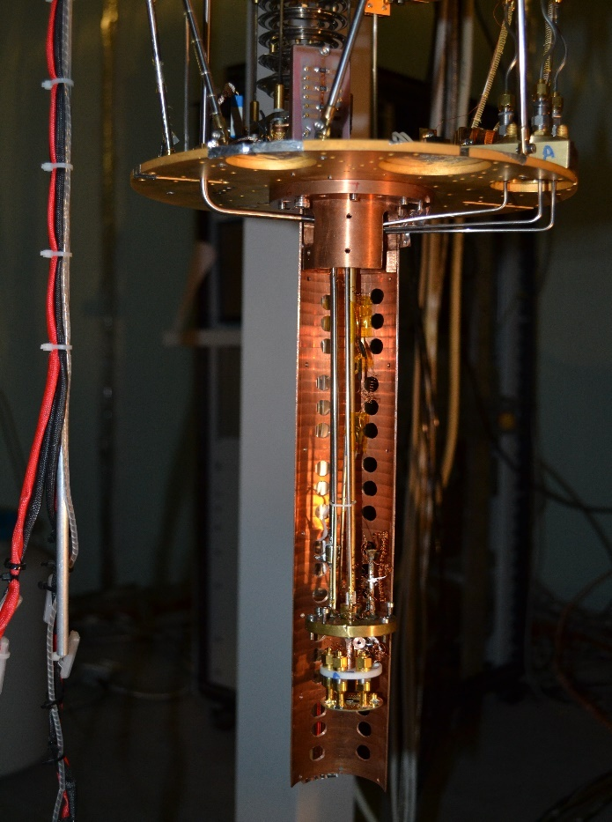
Measurement setups
Samples measured in a Cryofree dilution fridge with base temp ` 10 mK
Equipped with a 2-axis magnet.
Mixing Chamber
Cold Finger
Sample Stage

Slide 54
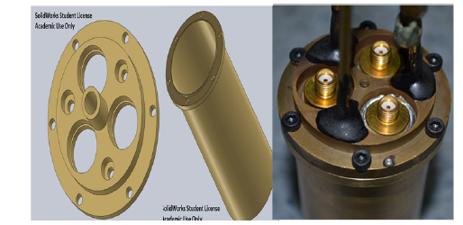
Home made RF hermetic Seal for H2
Mr Abhishek Kumar MS Thesis

Slide 55
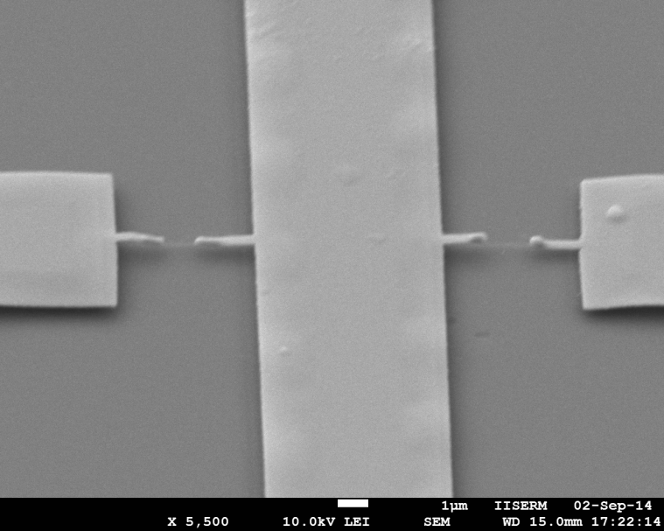
Pd with H2
Pd beams whose mechanical properties are modified drastically by H2 absorption.
Two similar beams exhibited symmetry breaking in extreme buckling under 10 mtorr of H2 as exchange gas One had ~ 18 MHz & 43 MHz resonant frequency
Negative frequency pulling not characteristic of
Metallic beams at cryogenic temperatures .

Slide 56
Typical linear response of a Palladium beam
Except for minor differences due
to noise the curves fall on top
Of each other.

Slide 57
Example of a systems in duffing regime
A stressed Silicon Nitride beam in Duffing regime
From K.J. Lulla PhD thesis Univ of Nottinggham
and New J of Phys
A Palladium Beam showing frequency pulling
But also drop in amplitude.

Slide 58
Typical s21 response
Slight enhancement of normalized S21 amplitude
Normalized Amplitide drops to lower values
when driven hard with broadening of response.

Slide 59
TLS pumping
Q is expected to increase as environmental
Qubits are saturated at higb drive powers
Our system enters a non-linearity at the same
Time
Saturation seen in MKIDs , SAW devices etc
From Shelender Kumar Thesis

Slide 60
Absence of hysteresis with sweep direction

Slide 61
Hysteretic response in a gold beam

Slide 62
Higher temperatures

Slide 63
Calibration from linear response
S21 is calibrated top voltage using ~ 50 ohm load. Beam impedances
a few ohms and is also forming a bridge. External attenuation power
And amplification factors are used to get F= ILB
Peak amplitude estimated from beam paramaters in linear regime
Caveat Beam l and Z are not exact but gives a self
Consistent response of a system.

Slide 64
Effective Spring Constants
K_{eff} ~197 N/m
K_{eff} ~ 129 N/m
Spring Constant estimate for H2 exposed sample
Spring Constant estimate for H2 vacuum cooled sample
Forces range is almost double showing it is harder

Slide 65
Un-normalized amplitude
Linear Q ~ 19500
Linear Q ~ 9800

Slide 66
simulations
Numerical Simulations were done in limit of a secular perturbation expansion
Cross, M.; Lifshitz, R.
In Review of Nonlinear Dynamics and Complexity;
Schuster, H., Ed.; Wiley: New York, 2008; Chapter 1

Slide 67
Simulations of nonlinearly damped duffing system

Slide 68
simulations

Slide 69
Perturbative solutions
Peak Amplitude
Frequency Pulling
Line Width

Slide 70




Frequency pulling
Quadratic fits to frequency shift --→
We are still in
Secular perturbation limit
Growth of absolute amplitude also indicates same
a ranges from
(0.92−1.9) ×10¹⁷ kg m−2 s−2
Backbone curve

Slide 71
Qualitative Line width vs resonant frequency
Slope becomes
Weaker with temperature
γ only fixes
Initial condition
η determines
Slope with
Z₀²
Implies Line width vs F_Resonance
Is linear .
Although line-width
is a qualitative estimate for our
Non-Lorentzian line shapes.

Slide 72
Fits to peak response
Term vanishing to zero at
F_res allows to solve for Z_max algebraically.
Amlitude expected to follow an analog of Back-bone curve for F_res.
Imboden and Mohanty Nanoletters.

Slide 73
Fit to peak response
Curvature of solutions at
Wekens ~ 1K temperature
Curvature of solutions at
Lowest temperatures.

Slide 74
Temperature dependence of non-linear damping
Linear drop in
η with temperature
First observed
Low temperature
dependence of η
Indicating it is not due
to clamping points

Slide 75
Non-linear damping observed so far in NEMS and Mems systems
Carbon Nano-tubes and Graphene Eichler, A.; Moser, J.; Chaste, J.; Zdrojek, M.; Wilson-Rae, I.; Bachtold, A. Nonlinear damping in mechanical resonators made from carbon nanotubes and graphene. Nat. Nanotechnol. 2011, 6, 339– 342, DOI: 10.1038/nnano.2011.71 No temp dependence at mK and few Kelvin temperature
Long AuPd beams of mm scale length Zaitsev, S.; Shtempluck, O.; Buks, E.; Gottlieb, O. Nonlinear damping in a micromechanical oscillator. Nonlinear Dynamics 2012, 67, 859– 883, DOI: 10.1007/s11071-011-0031-5 only room temp study in KHz freq beams
Diamond nanobeams Imboden, M.; Williams, O. A.; Mohanty, P. Observation of Nonlinear Dissipation in Piezoresistive Diamond Nanomechanical Resonators by Heterodyne Down-Mixing. Nano Lett. 2013, 13, 4014– 4019, DOI: 10.1021/nl401978p No temp depence from 77K to 55 mK
Graphene drums Miao, T.; Yeom, S.; Wang, P.; Standley, B.; Bockrath, M. Graphene Nanoelectromechanical Systems as Stochastic-Frequency Oscillators. Nano Lett. 2014, 14, 2982– 2987, DOI: 10.1021/nl403936a
Amplification! in Graphene drums Vibhor Singh et.al Phys. Rev. B 93, 245407 2016 intermodal storage of energy possibly
NO TEMPERATURE DEPENDENCE SEEN OR REPORTED SO FAR IN LITERATURE

Slide 76
What can cause observed drop of damping with temperature
Atalaya, J.; Kenny, T. W.; Roukes, M. L.; Dykman, M. I. Nonlinear damping and dephasing in nanomechanical systems. Phys. Rev. B: Condens. Matter Mater. Phys. 2016, 94, 195440, DOI: 10.1103/PhysRevB.94.195440 Gave a detailed scenarios of various Phonon mediated Non-linear damping Phenomena
Thermoelastic Damping Increases with temperature as more phonon states are available.
Joule heating : Only few 10 pW of power applied to a metallic beam. These powers are very low compared to other dielectric NEMS devices that do not show heating at higher temperatures
Clamping loss : Will not show temperature dependence at these temperatures as thermal contractions are very minimal for this range.
Diffusion induced damping : H2 Diffusion will produce frequency jumps over several cylces. The f_0 was same over several months of measurements
Linear Akhiezer Damping To weak for device parameters like spring constant and frequency.

Slide 77
Non-linear Akhiezer damping
Correlator for Phonon-Phonon
Interactions in terms of dimensionless
Deformation potentials producing
Non-linear damping. Correlators are
Related to a Non-linear Gruneissen
Parameters. They vanish for isotropic
Systems.
τ_{r} propotional to T ⁻⁵
Denominator is 1 for large
ω_₀
Specific heat of material
T³ dependence

Slide 78
NON-Linear Akhiezer damping
Deformation potentials related to non-linear
Gruneissen Parameters.
The Cubic elastic constant α is related to
the microscopic deformation potential V.
α ∼ 0.9 −2.0 x 10¹⁷ kg m−2 s−2 for H2 exposed sample
α ∼9.5x 10¹⁵ kg m−2 s−2 for vacuum cooled sample @ 160 mK
η ~ 2 x 10⁸ Kgm-2 S-1 for H2 exposed samples at 110 mK
η ~ 1.16 x 10⁷ Kgm-2 S-1 for vacuum cooled samples @160mK

Slide 79
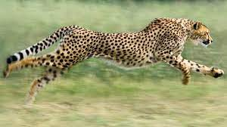
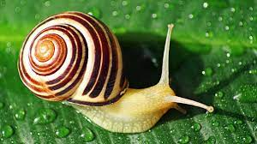





Conditions to see non-linear akhiezer damping
Phonon Position
Time
Mean free path of phonons in AuPd
Films ~ 25 nm so phonons may
Bounce across the beam width.
Kanskar, M.; Wybourne,
M. Phys. Rev. B: 1994, 50, 168– 172,
Beam state

Slide 80
Enhancement of Gruniessen constants
Linear Gruniessn constants are known to be enhanced for Bulk Palladium by a factor of 2 in alpha hydride state i.e , a > 50% H2.
We are not close to 50% H2 but small profile of beam may deform it significantly to enhance Duffing Non-linearity thereby enhancing damping also.
To not have the correlators of the deformation potentials washed our we need more crystalline ordering.
The fact the Pd seems to have more oriented films the Al or Au seems to be the reason.

Slide 81
Grains in Au and Palladium films
Grains in Pd films forming the
device
Grains in Au films

Slide 82
Future prospects
Measure thermal Conductivity using RF+DC measurements
Measure devices of Different aspect ratio to see if Damping is different.
Measure alloys of Pd to enhance only α

Slide 83
Diffusion induced damping

Slide 84
Elastic anomalies
Makiuchi, T., Yamashita, K., Tagai, M., Nago, Y. and Shirahama, K. (2019a). Elastic anomaly of thin neon films. Journal of the Physical Society of Japan, 88(3):034601.
Makiuchi, T., Yamashita, K., Tagai, M., Nago, Y.,and Shirahama, K. (2019b). Multiple diusion-freezing mechanisms in molecular-hydrogen films. Physical Review Letters, 123(24):245301.

Slide 85
NEON ~ 5K
Data and pics from Makiuchi, T., Yamashita, K., Tagai, M., Nago, Y. and Shirahama, K. (2019a).
Elastic anomaly of thin neon films. Journal of the Physical Society of Japan, 88(3):034601

Slide 86
Towards diffusive H2 molecules

Slide 87
Surface Diffusion in Palladium beams
Anomalous peak in df/fo
Q-1 and df/fo ignoring the anomalous peak
Fits the activatin picture with Ta ~ 9.5K

Slide 88
Sliding friction of dipolar adsorbates across a superconducting transition
Not repeatable in CW or Ringdown
measurements by othee groups
We have some preliminary proofs
Of repeatability of these experiments
A. Dayo et.al Phys Rev Lett

Slide 89
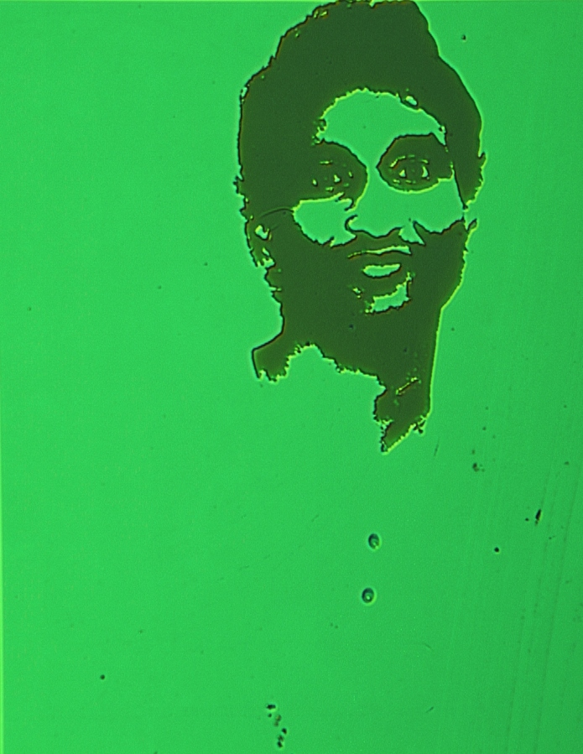


Our group Members and activities
Rest of group
Members are former
MS , PhD and
PDF
O
One former MS
Student
Dr Indrjaeet Sagar
Is at
IQM Finland
Mr Shyam Sundar
Novel high quality
2-DEGS on SrTiO3
Image on PMMA
Mr Pankaj Sahu
Will continue similar
Work
Dr Shelender Kumar
Main student in this work and related
MEMS activities

